Slide 1




Slide 2

What is Safeguarding?
Safeguarding is defined in Working Together to Safeguard Children (2013) - guidelines produced by the government - as:
  protecting children from maltreatment
  preventing impairment of children’s health and development
  ensuring that children grow up in circumstances consistent with the provision of safe and effective care
  taking action to enable all children to have the best outcomes

Slide 3


Who is responsible for safeguarding?
Safeguarding is everyone’s responsibility.
Consider why it is everyone’s responsibility…

Slide 4
You should talk to the Safeguarding Team if:
You feel unsafe or not cared for at home You feel unsafe at college You feel unsafe in any aspect of your life including online You feel suicidal You feel like harming yourself You have nowhere safe to live You feel you are being emotionally abused You feel you are being made to behave in a way that makes you feel unsafe You feel you are being bullied You have a criminal conviction

Slide 5

Your friend, Tom, lives with his mum & 7 yo sister and you know money is tight. One day Tom tells you that when he goes home he doesn’t get anything to eat. His mum says the food is for his sister, not him. He relies on his bursary food on college days.
Notes:
This is a potentially neglectful home environment and one where a much younger child is also potentially at risk. Students should let their teacher know or contact the safeguarding team directly with their concerns. By doing this they would be ensuring that Tom’s family are safeguarded as the safeguarding team would be able to contact other agencies who would hopefully result in more support being put in place for the family and the route of their difficulties being addressed.

Slide 6
Your friend, Emma, is unusually quiet one day. When you ask her what is the matter she eventually tells you her parents had an argument the night before and she saw her mum threatening her stepdad with a knife. It’s not the first time she’s seen them fighting and her two younger siblings were also in the room watching.
Notes:
This is a very serious incident which if observed in a public place would likely result in police involvement, arrest and a criminal record. It is no less serious in a domestic setting. In fact it could be considered more serious as it leaves vulnerable people including children at risk and no one informed. That is unless you as Emma’s friend inform your teacher or the safeguarding panel. The family need help to ensure all members of the family are safe and that the route of their anger is understood and worked on.

Slide 7
Andy is boasting in the smoking area that he had a row with his sister at the weekend and slashed some of the clothes in her wardrobe with a Stanley knife.
Notes:
Brothers and sisters argue, without a doubt! However behaving so angrily or vengefully by using a knife to damage property is worrying and very unfair to the sister. The lack of remorse also indicates that this could happen again and willingness to use a knife puts people at risk as well as property. His anger or revenge could escalate to using the knife against his sister.

Slide 8
You notice Sam has got scratch marks on his arm that you haven’t seen before.
Notes:
Consider what could have caused these? Could someone have hurt Sam? Could Sam have hurt himself? Could it be a pet who has scratched him? You won’t know unless you broach the subject which should be done carefully. If you don’t really know Sam – if he is an acquaintance not a friend - it would be better for a teacher or the safeguarding panel to discuss his injuries with him. Even if he is your friend you may think he won’t react well to you asking about the scratches and equally you should refer to a teacher or the safeguarding team. You might think that scratches instead of deeper cuts don’t constitute self-harm but any kind of self-inflicted injury may constitute self-harm.

Slide 9
Amy (16) has been telling you about her 25yo boyfriend who takes her to his mates parties and gives her drugs and drink. Today she tells you this weekend they are going to visit some of his other friends in London for the weekend.
Notes:
Consider why a 25 year old wants to hang around with 16 year olds. Their intentions may not be good. They may be looking to exploit young people by taking them to parties, giving them gifts, making them feel special and then expecting them to have sex with one or several people in return. This constitutes grooming leading to sexual exploitation and is a serious criminal offence in which victims need to be protected and supported. Of course lots of young people go to parties but if they are a long way from home, with much older people and involve a lot of drink and drugs this is concerning. You should let your teacher or the safeguarding panel know that you are concerned about where your friend is going. They can offer her advice to stay safe and discuss the difference between an honest, loving relationship and an exploitative one as well as contacting other agencies for advice and to flag their concerns in case people involved are already known to other agencies, eg the police.

Slide 10
Remember: safeguarding is everyone’s responsibility.
Please take your phones out and record the safeguarding number in them: 07900 684493
You can call or text with any of the concerns we have mentioned. The safeguarding team is mostly made up of members of the Student Support team so you may already know some of them or will become familiar with them during your time here. They are based on the top floor of Austen building next to the Success Centre study area.

Slide 11


Slide 12
What is Prevent?
Part of the Government Counter Terrorism Strategy
Aims to reduce the risk to the UK from terrorism
Targets all forms of extremism, including Extreme Far Right, Animal Rights Extremism, ISIS and Al Qaida influenced terrorism.

Slide 13
What will be covered in the session
Who, why and how?
Meanings: grievance, terrorism, extremism and radicalisation
Process and consequences (through the Pathways film)
What can you and society do about it?
Pathways is a short film which portrays the process of
radicalisation among young people

Slide 14
Icebreaker 1
What does a terrorist look like?
Consider stereotyping and prejudices

Slide 15
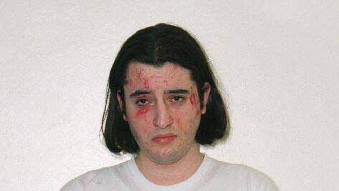
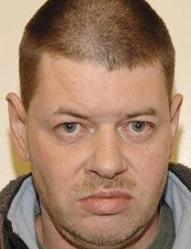
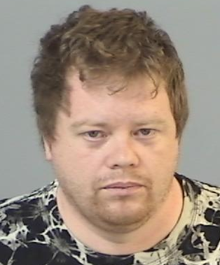
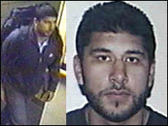
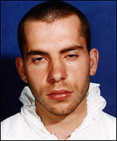
What does a terrorist look like?
Younes Tsouli
Aka: Terrorist 007 Cyber- Jihadist
Moroccan born
Developed virtual terrorist networks to radicalise the young online and help them carry out terrorist attacks
Neil Lewington
Right-wing white supremacist
Developed a bomb-making factory at his flat in Reading with the intent of carrying out acts of terrorism against Asian families
Mark Colborne
Aryan right-wing extremist from Southampton
Felt victimised for his ginger hair. He plotted a cyanide attack; also to kill Prince Charles and William so red-haired Harry could be king
Hasib Hussain
7/7 suicide bomber (2005)
Aged 18, the youngest of 4 suicide bombers who detonated bombs in the underground; his detonated on board a bus in Tavistock Square
David Copeland
London Nail Bomber
Right-wing white supremacist
From Yateley in Hampshire, he made and detonated a bomb in Brixton and a nail bomb in Soho

Slide 16
Common Words Simplified
Terrorism
Any act designed or intended to cause terror:
usually based on a political objective
Radicalisation
The process by which a person comes to support
terrorism and forms of extremism leading to
terrorism
Radicaliser: individual who encourages others to develop beliefs/views
supportive of terrorism and forms of extremism leading to terrorism
Radicalisation materials: cyber, writing, videos intended to influence

Slide 17
Common Words Simplified
Extremism
Literally means driving (something) to the limit, or to the extreme.
Today, the term is mostly used to refer to extreme political or
religious matters
Extremist
A person who holds extreme political or
religious views and supports illegal, violent, or
other extreme action
Grievance
A circumstance regarded as just cause for complaint
Resentment stemming from a feeling of having been
wronged

Slide 18
Common Words Simplified
Ideology
A set of beliefs or theories, usually political, held
by an individual or a group
Narrative
Narrated account = a story such as those related to
political views or religious beliefs
Propaganda
Information, ideas, or rumours deliberately spread
widely to help or harm a person, group, movement,
institution, nation, etc.

Slide 19
Icebreaker 2
Why does a person become a terrorist?
Consider grievances, values, attitudes, beliefs

Slide 20
What makes a person become a terrorist?
Need to belong or feel part of something
To correct what they believe is social, political, or historic injustice
Looking for an identity
Relate to or sympathise with a particular group/cause
Make a stand for their beliefs
Grievances: angry, isolated by peers, discriminated
Vulnerability: radicalised/groomed ~ Jihadi brides
(list not exhaustive)

Slide 21
Icebreaker 3
Why does it happen?
Consider beliefs, emotions and experiences

Slide 22
Why does it happen?
For retribution or to avenge others/groups
For media attention - propaganda
Generate fear and unrest
Belief that violence or its threat will be effective for change or the ‘greater good’
No choice: no other non-violent way to achieve the desired change
(list is not exhaustive)

Slide 23
Watch the Pathways film
https://www.youtube.com/watch?v=W9TvpatWOJ8
Consider why each of the characters behaves as they do:
Are any of them being radicalised? What made them vulnerable to this?
Who is doing the radicalising? Why do they believe their behaviour is ok?

Slide 24
What can I do?
Recognise
Signs of Radicalisation and Extremism
Use of inappropriate language
Possession of violent extremist literature
Use of internet to explore extremist material
Behavioural changes
Expressing extremist views
Advocating/supporting violent actions and methods
Association with known extremists/groups
Seeking to recruit others to an extremist ideology
(list is not exhaustive)

Slide 25
What should I do?
If you think someone may be trying to groom or radicalise
you or someone you know … Get advice..
Its ok to ask….Speak to adult for advice if you’re not sure
Talking can help keep you and/or your friends safe from extremist behaviour and help prevent future acts of terrorism
Teacher
Parent or Carer
Police Officer
Youth Worker
Family Member
Social Worker
The fight against terrorism is everyone’s responsibility

Slide 26

Who to contact
Hampshire Constabulary
For advice or support call 101 or e-mail the prevent team:
prevent.engagement@hampshire.pnn.police.uk
Call 999 if you or others are in immediate danger
Follow us on Twitter: @PreventHants
The Anti-Terrorist Hotline: 0800 789 321
To report any concerns or information you have of terrorist activity
The Government webpage: www.gov.uk/report-terrorism
To report anonymously any terrorist information, pictures or videos you find on the internet

